Slide 1
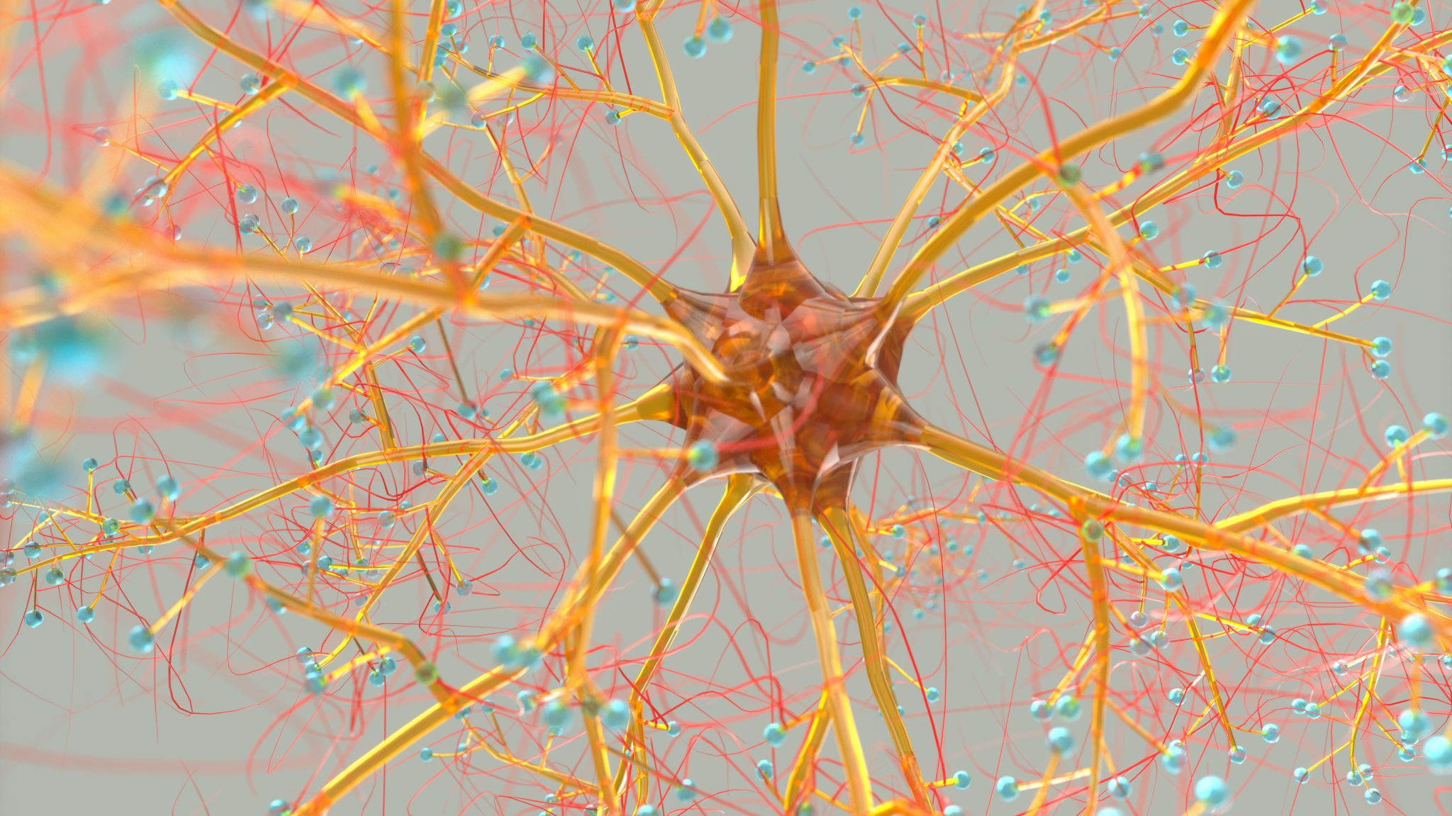
Neural Networks Recommendation System
on Amazon Reviews Dataset

Slide 2
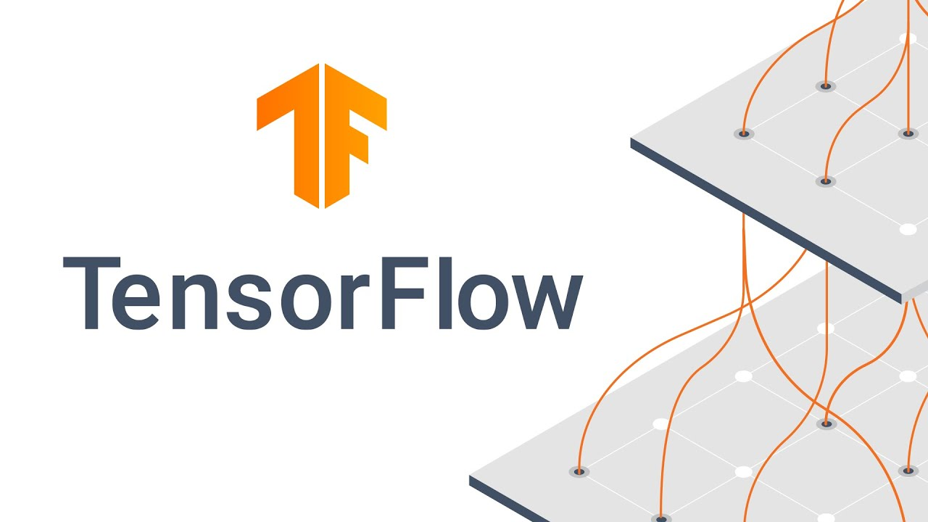
OBJECTIVE: Explore Neural Networks by using TensorFlow Recommenders to address Cold Start problem.
PROJECTED OUTCOME: Test Retrieval, Ranking, Sequential models.

Slide 3
Outline
BUSINESS PROBLEM
DATA AND METHODS
RESULTS
CONCLUSIONS

Slide 4
Business Problem
Stakeholder: Marketing team
Low user penetration in US (20% at 2022)
Cold Start Problem

Slide 5
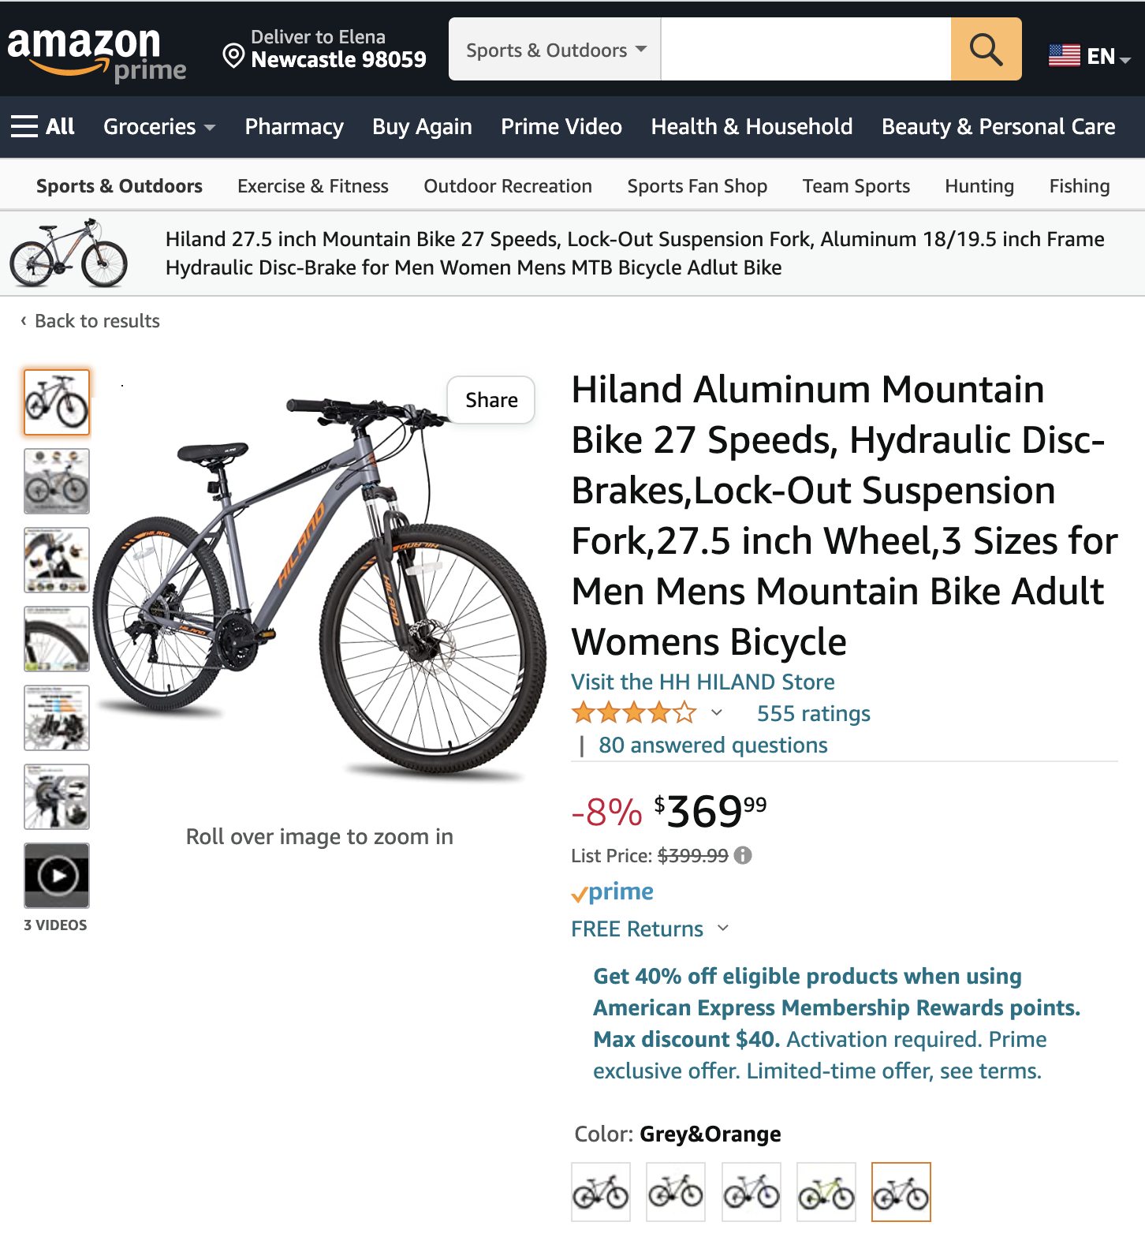
DATA & METHODS
DATA:
2.3M Outdoor product reviews (2000 – 2015)
FEATURES:
Product title, review title, review, review date, votes
DATA SOURCE:
Amazon Reviews dataset
RECOMMENDATION SYSTEMS:
Retrieval
Ranking
Sequential
Combined Features

Slide 6
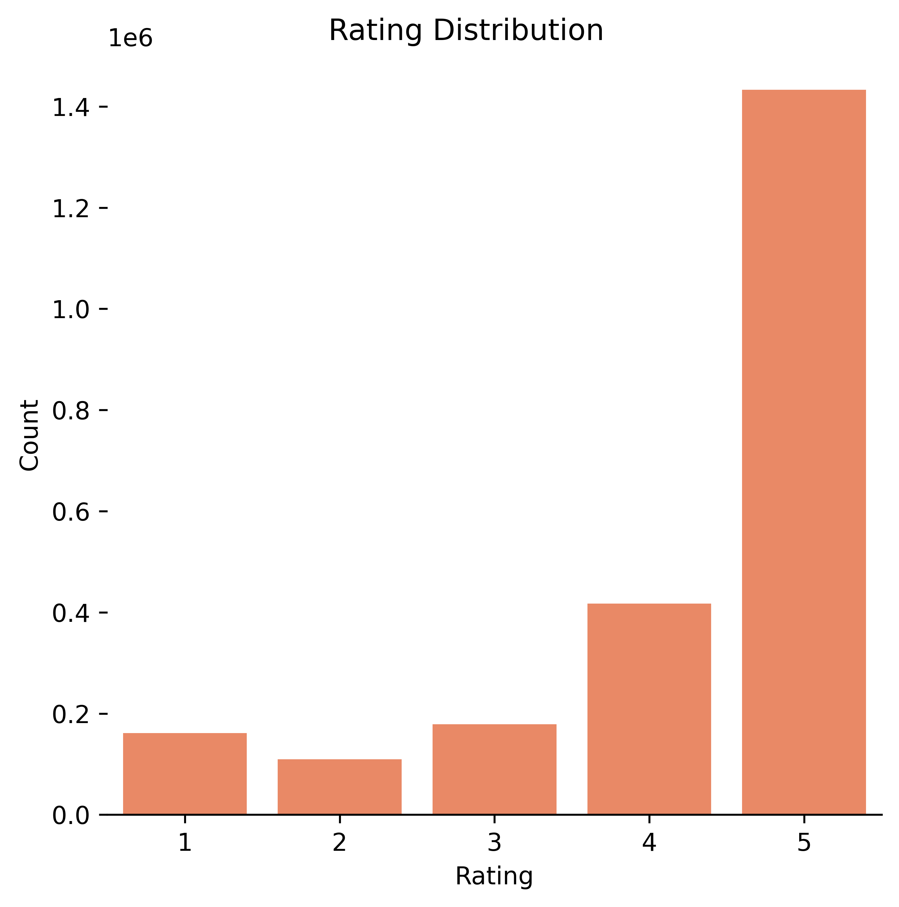
Star Rating Distribution:
62.4% - 5 star
18.1% - 4 star
7.6% - 3 star
4.7% - 2 star
7.1% - 1 star
Rating distribution is skewed left indicating that customers tend to leave positive ratings.
Notes:
Add KDE
Get rid 1e6

Slide 7
Since 2008 the number of reviews has been progressively increasing each year with more than doubling in 2013.

Slide 8
SoundAsleep Dream Series Air Mattress
Intex Pillow Rest Raised Airbed
Hydro Flask Insulated Water Bottle
Intex Raised Downy Airbed
LifeStraw Personal Water Filter for Camping
Notes:
Ticks large – use white space

Slide 9
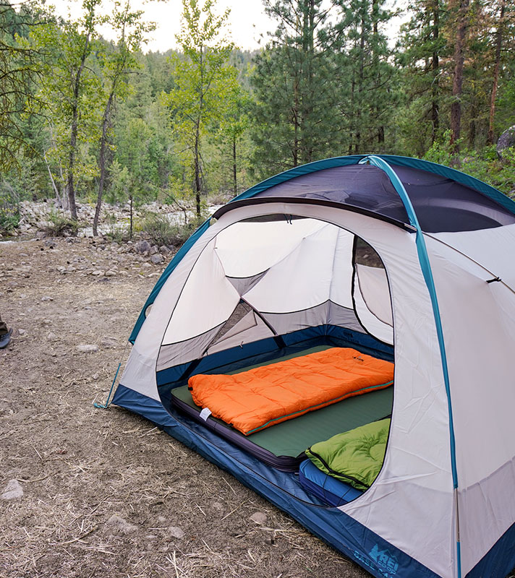

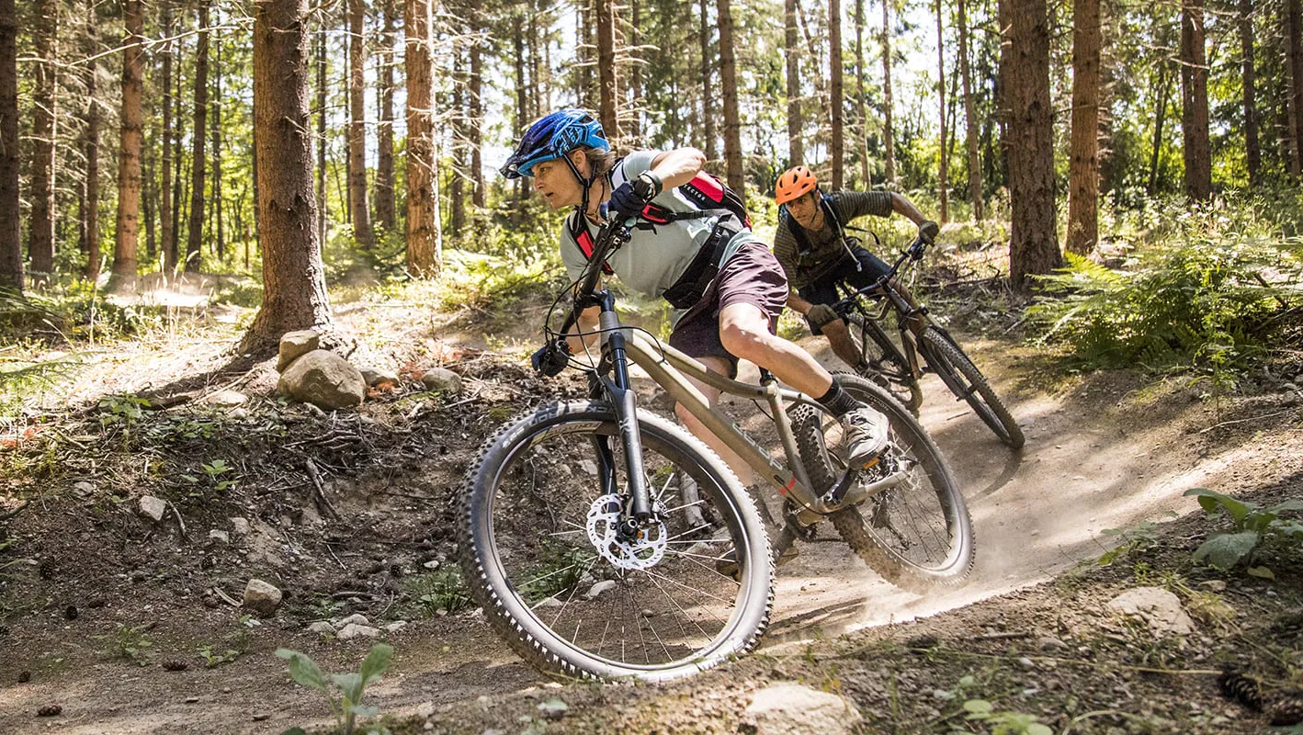
Test User
Mountain biking
Camping
Does have a kid

Slide 10
ITEM-TO-ITEM Retrieval Model (tuned)
Top-K Categorical Accuracy Rate on Test Data
115K subset dataset 2.3M full dataset
Top-1 36% 95.9%
Top-5 49% 96.12%
Top-10 58% 96.12%
Top-50 68% 96.13%
Top-100 70% 96.18%

Slide 11
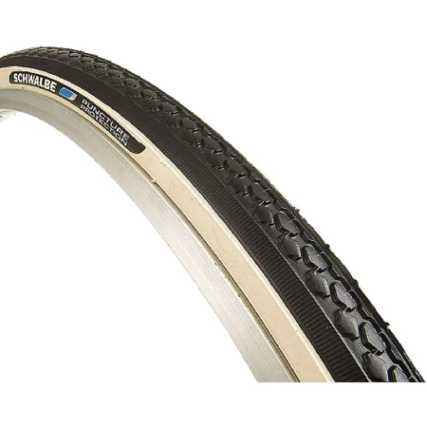
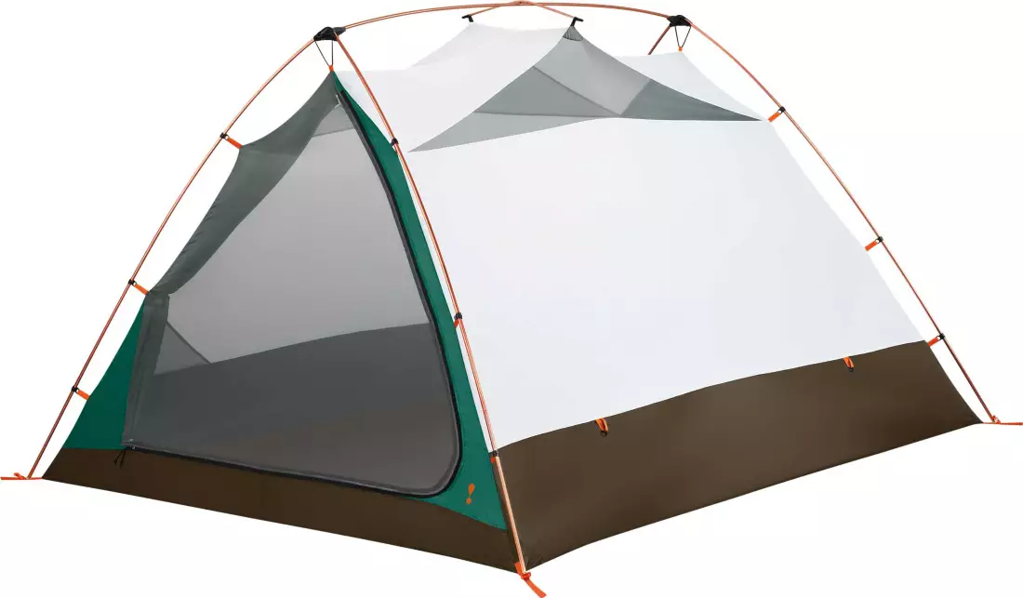
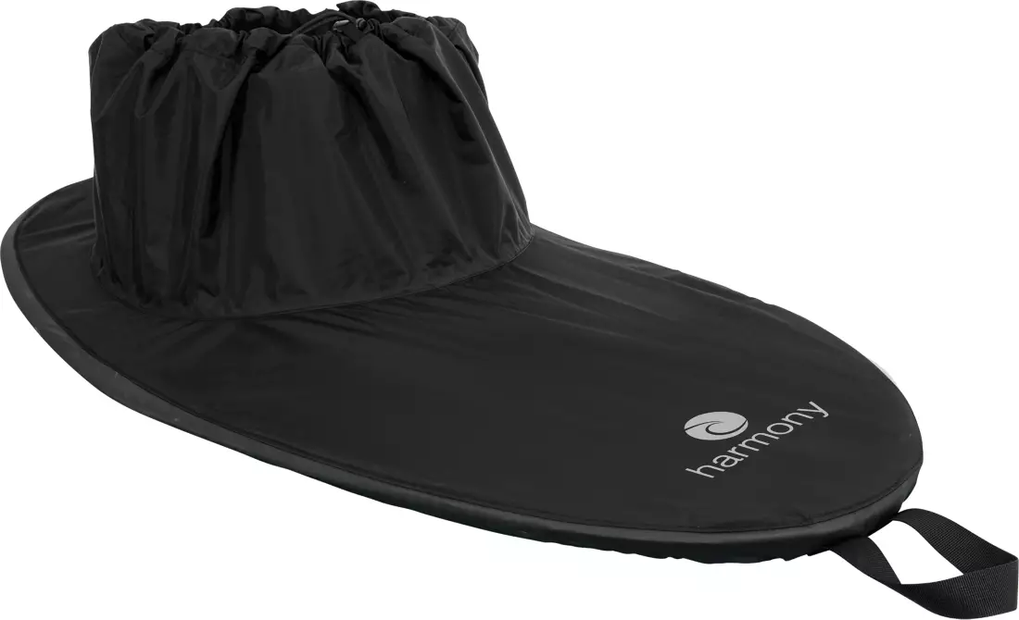
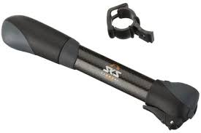
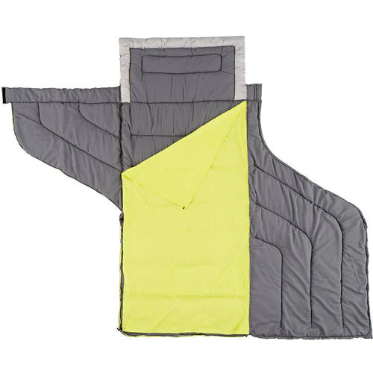
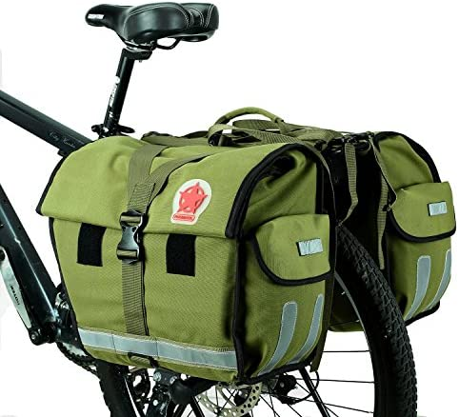
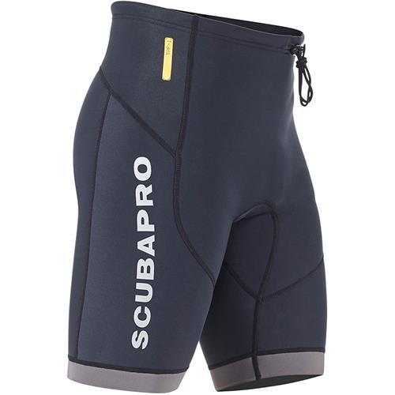
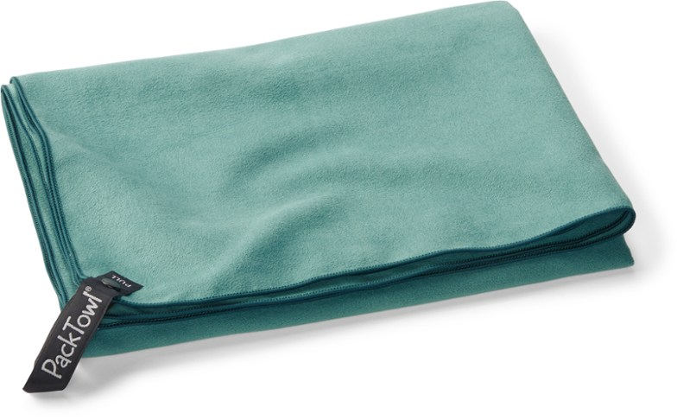
Top-10 Recommendations on Subset Data

Slide 12
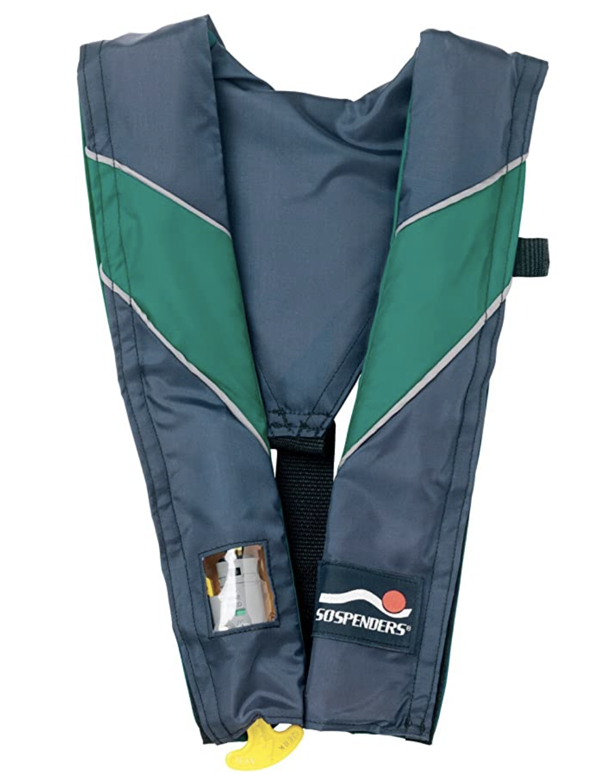
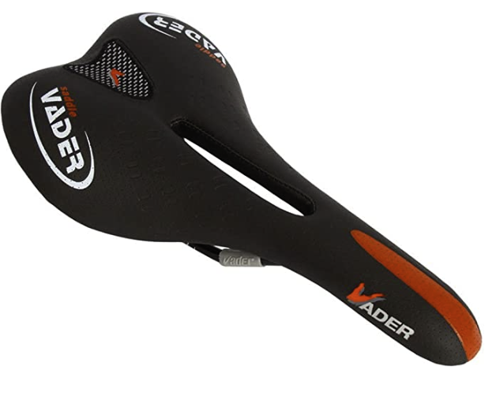
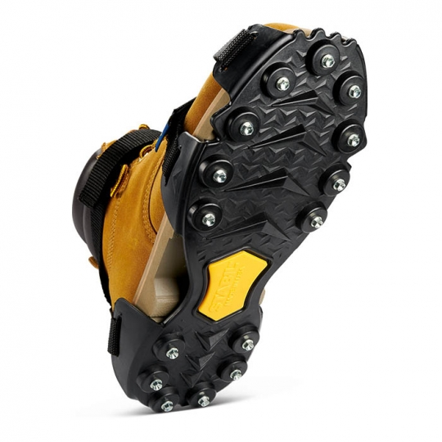
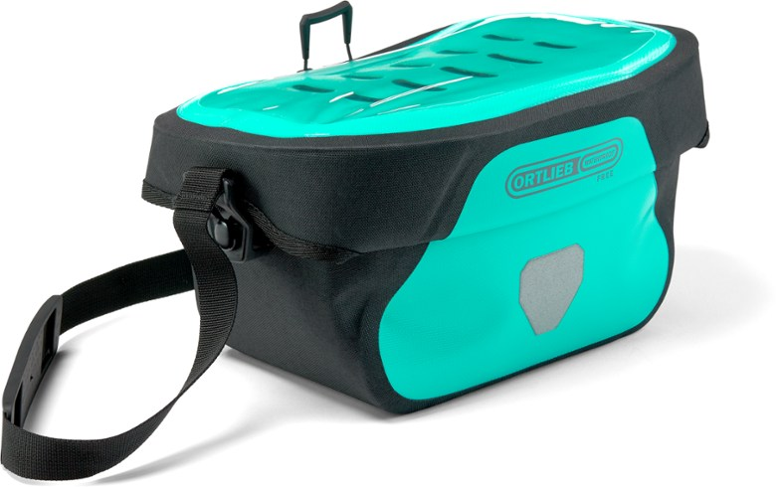
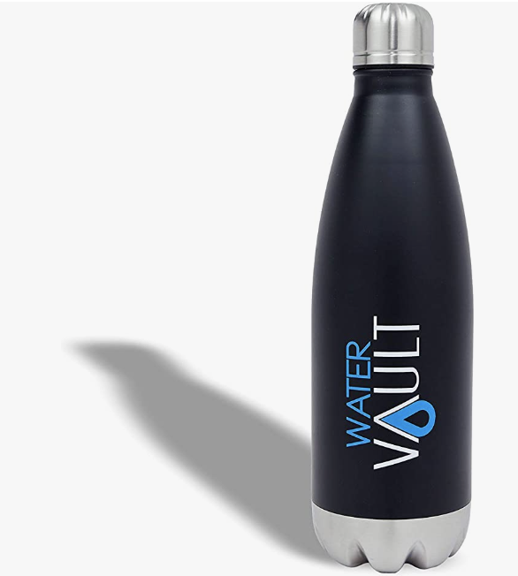
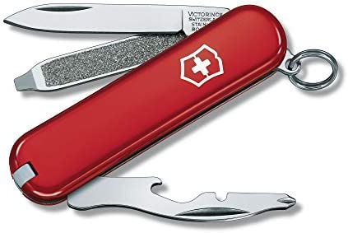
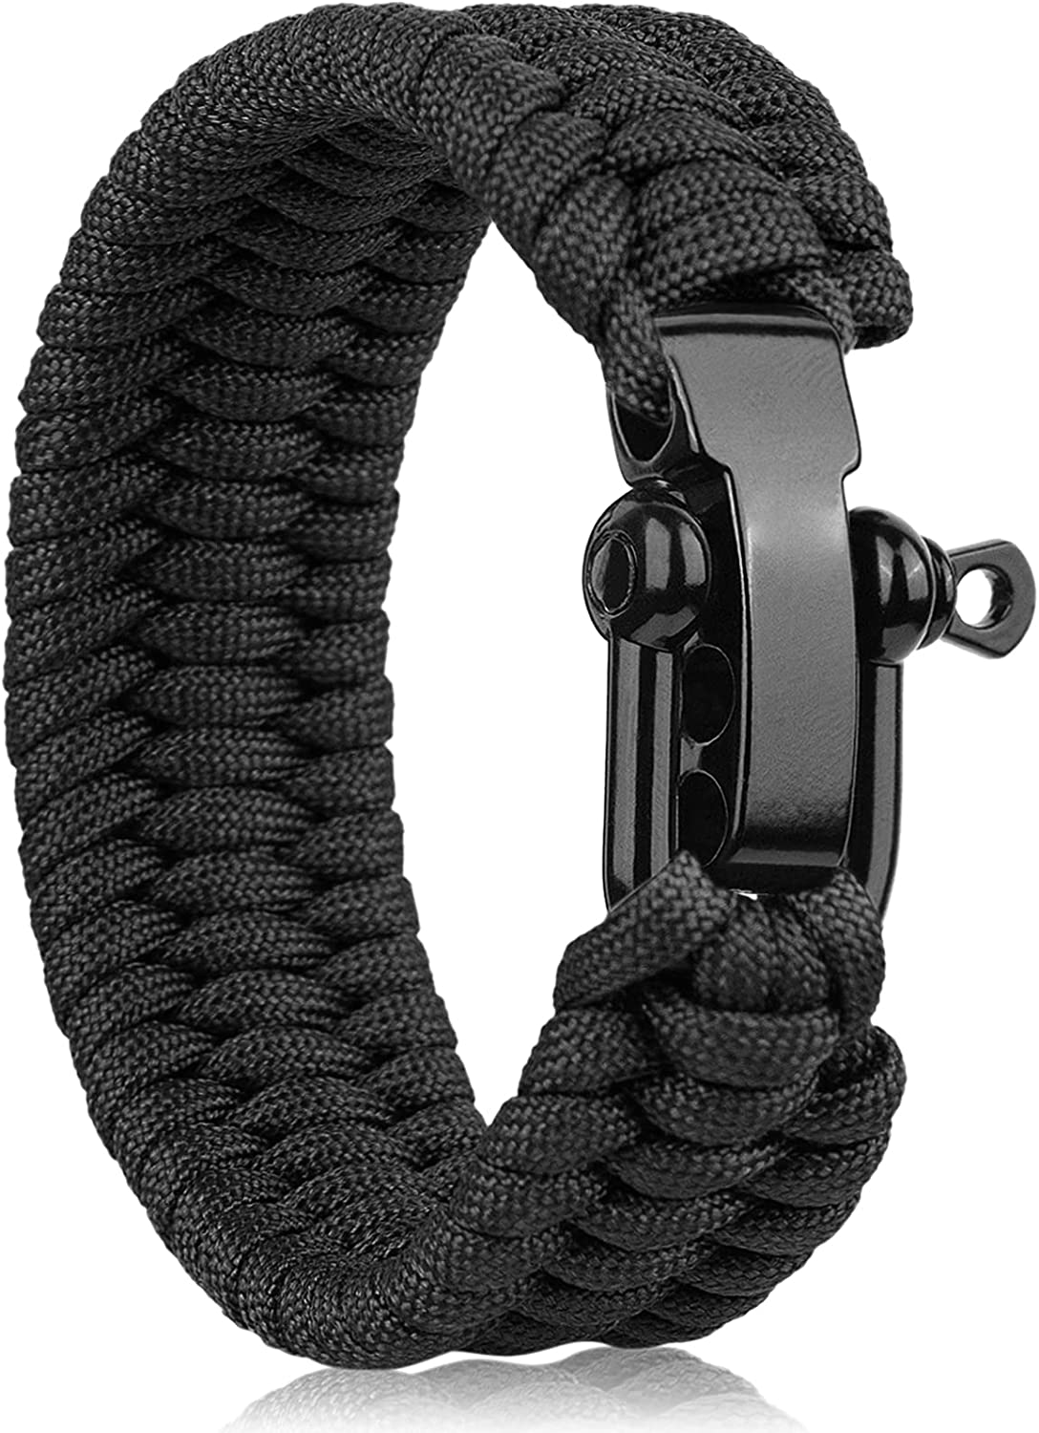
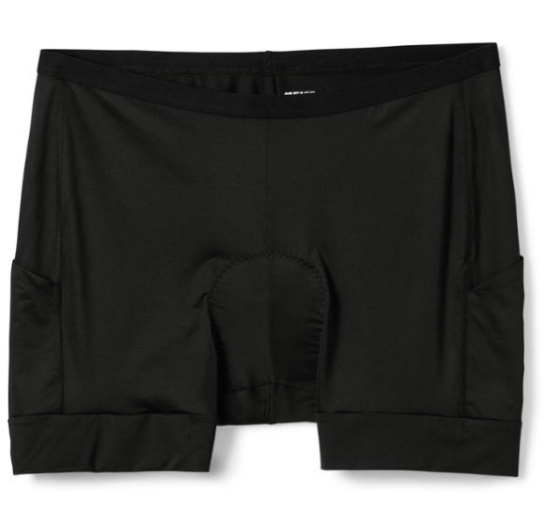
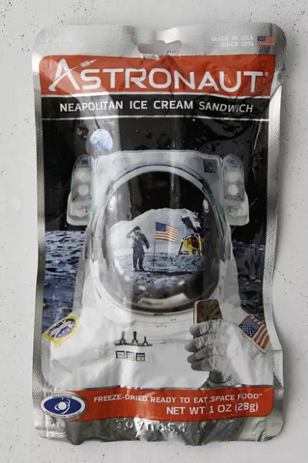
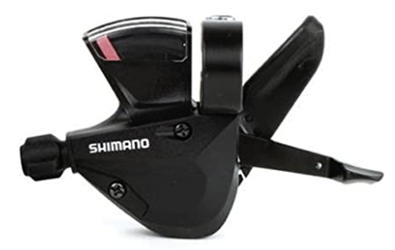
Top-10 Recommendations on Full Data

Slide 13
BruteForce vs ScaNN Serving Performance
BruteForce and ScaNN retrieved the same Top-10 recommendations
BruteForce 5.29 ms
ScaNN 4.55 ms
ScaNN is 15% faster than BruteForce at the same accuracy rate of 96%.

Slide 14
BUSINESS RECOMMENDATIONS
A/B test item-to-item Retrieval TensorFlow model on the website.
Implement ScaNN for efficient and fast serving.

Slide 15
NEXT STEPS
Scrub
Scrub current data from Amazon.com to run the models on the up-to-date dataset.
Explore
Further explore TensorFlow Recommenders to build advanced machine learning models.
Incorporate
Incorporate time series data to fine tune Sequential models (RNN: Recurrent Neural Networks).
Run
Run Convolutional Neural Networks (CNN) on image and video data.

Slide 16

Thank you
Link to Notebook

